Slide 1

Bacchus Project’s Progress

Slide 2



Last Meeting Result
Design
Need a new design, color combos, choice of picture
Need to learn Adobe InDesign
Outline
Need to rearrange the content list
Need to fill up the content
Content
Need to find quantitative data
Need new links for further study

Slide 3

Design
Change of Logo
Change of Color Combos
Change of Pictures and learn how to use InDesign

Slide 4

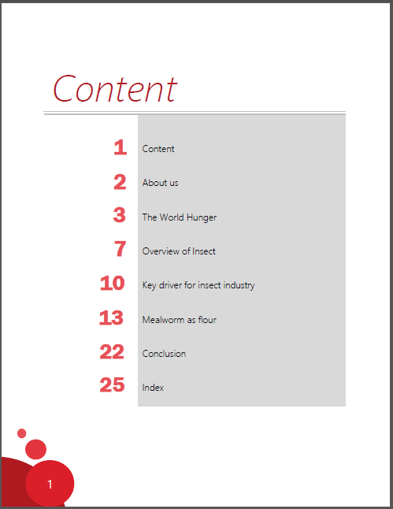
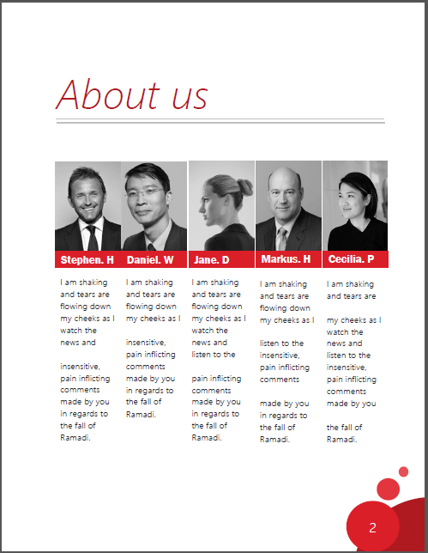
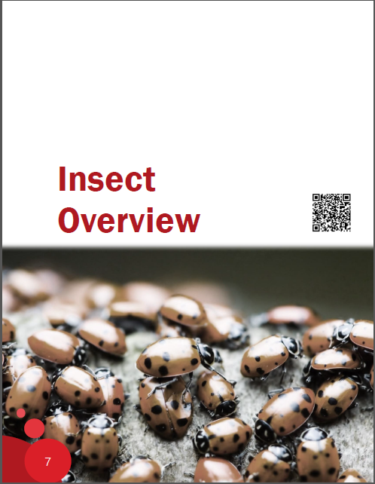
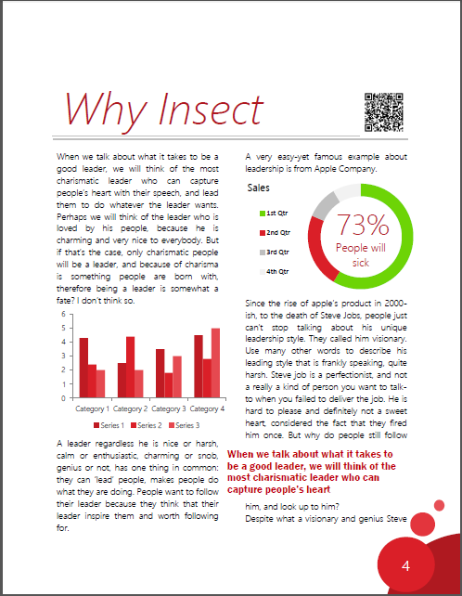
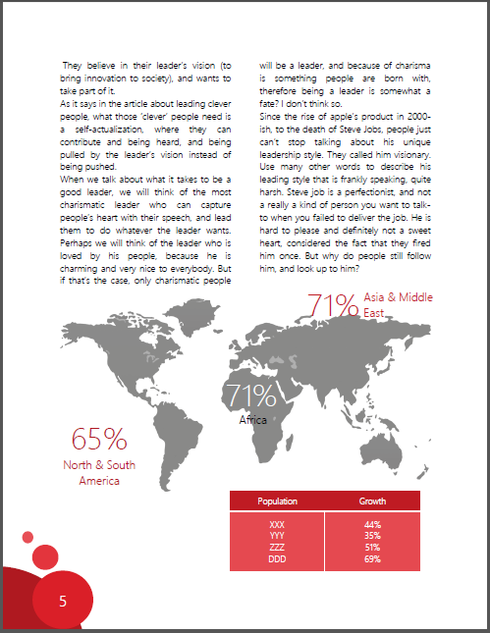
1st Option

Slide 5
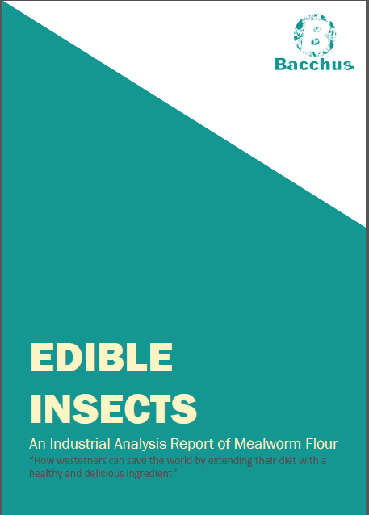
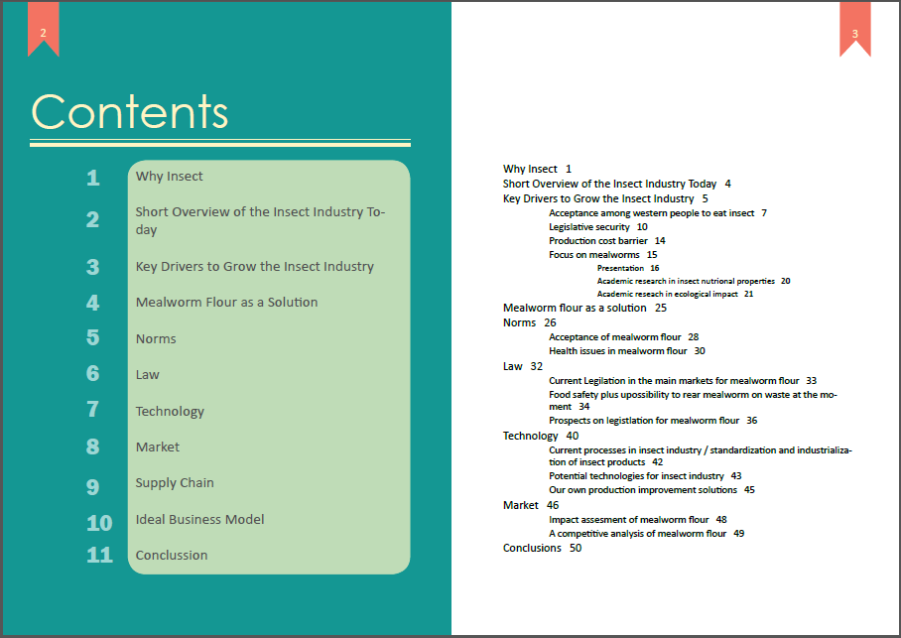

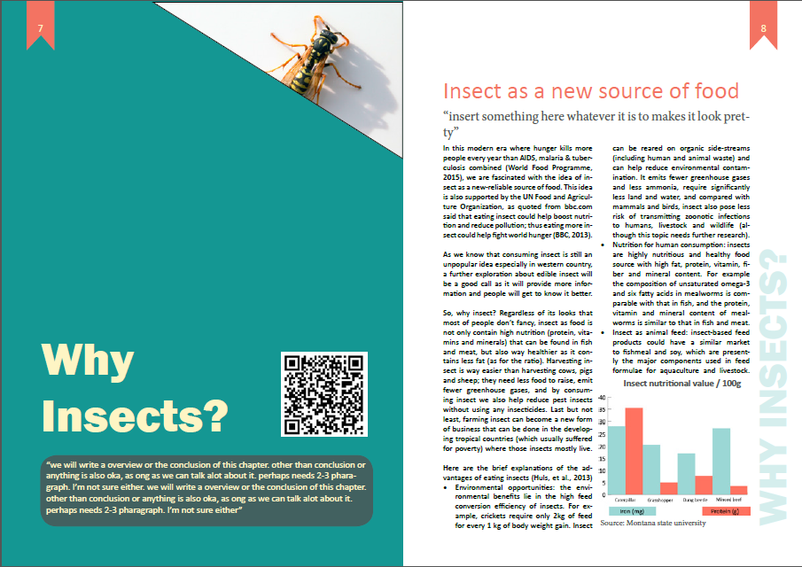
2nd Option

Slide 6
Outline
Report Overview |  | Progress (%) | What's inside
Why insect |  | 100% | Brief advantages of insect
Overview of the insect industry today |  | 50% | geographical consumption, market size, most eaten insect, insect production
Key drivers for insect industry
 | Acceptance among western people | 100% | Why eating insects disgust Westerners
 | Legislative security | 30% | insect as novel food in EU, regulation in Belgium and Netherlands
 | Production cost barrier | 0%
Mealwom flour as a solution |  | 100% | why we choose mealworm, the advantages of mealworm
Norms
 | Acceptance | 0%
 | Nutritional content and health benefits | 70% | The number of daily need & ratio
 | Environmental impact | 0%

Slide 7
Outline
Report Overview |  | Progress (%) | What's inside
Law
 | Current legislation in the main market | 20% | Belgium acceptance of 10 insect species
 | Prospects of law evolution | 0%
Technology
 | Current processes in insect industry/ standardization & industrialization | 50% | study about soybean
 | Potential technologies for insect industry | 50% | study about soybean
 | Our own production improvement solution | 0%
Market
 | Impact assessment | 100% | comparison with other product in terms of consumption and price
 | A competitive analysis (5 Porter Forces) | 50% | Rough sketch
Supply chain |  | 20% | transparent information in production
Ideal business model |  | 20% | template on market size

Slide 8
Content
Market Size – Impact Assessment
Human Consumption
Animal Consumption

Slide 9
Content
Market Size – Impact Assessment
Human Consumption
Animal Consumption
$4 for tofu
$12 for veggie sausage
$6 for veggie burger

Slide 10
Content
Market Size – Porter 5 Forces
Threat of Substitution:
Few competitor
Innovative product
Small target market
Unique product
Buyer Power:
Flexible from bulk to retail size
Web store as primary channel
Buyer aren’t sensitive to price
Low customer loyalty
Competitive Rivalry:
Few competitor
Innovative product
Small target market
Unique product
Threat of New Entry:
Pet consumption level producers are moderate – high
They can adjust their processes and produce human consumption level products
Production process is not difficult
No brand recognition
No patents held
Supplier Power:
Less than 50 suppliers worldwide
Small to medium size of company
There are some similar substitute product

Slide 11
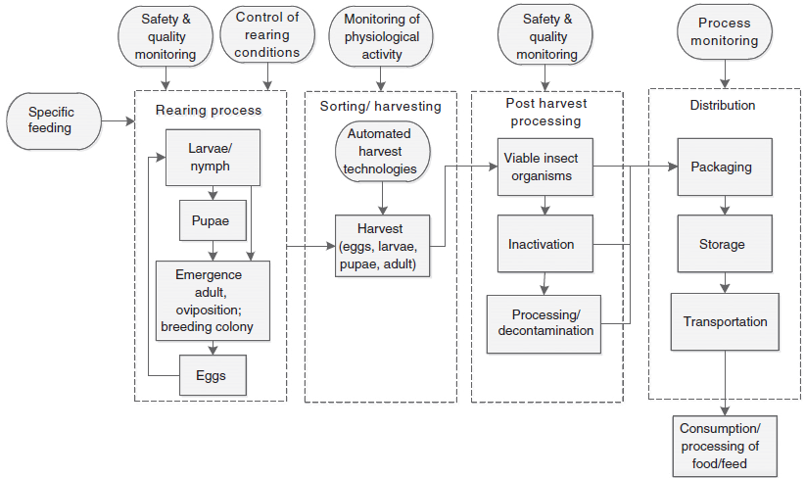
Content
Technology
“Schematic production process of food and feed derived from edible insects”
Source: Rumpold, Schluter, 2012

Slide 12

Content
Law - Acceptance
Asia 194
Europe 5
Oceania 49
Number of edible species around the world
America 545
Africa 185
Source: Rumpold, Schluter, 2012
FAO, 2013
Notes:
Do we need detail data? or is it not necessary?

Slide 13
Content
Norm – Nutritional Value
Ratio of nutrition content with daily recommended value
MEALWORM
Protein. Daily recommendation = 50g
Source:
FAO, 2012
www.wolframalpha.com
Fat. Daily recommendation = 65g

Slide 14




Content
Norm – Nutritional Value
Mealworm
206 kcal/100g
Beetle
138 kcal/100g
Beef
297kcal/100g
Human daily need: 1600 – 2800 kcal
Source:
FAO, 2012
www.wolframalpha.com

